Slide 1
React Patterns
by Stanislav Larionov

Slide 2
AGENDA
Event switch
Layout component
Container component

Slide 3
Event switch

Slide 4
When writing event handlers it's common to adopt the handle{eventName} naming convention.
handleClick(e) { /* do something */ }

Slide 5
For components that handle several event types, these function names can be repetitive. The names themselves might not provide much value, as they simply proxy to other actions/functions.
handleClick() { require("./actions/doStuff")(/* action stuff */) }
handleMouseEnter() { this.setState({ hovered: true }) }
handleMouseLeave() { this.setState({ hovered: false }) }

Slide 6
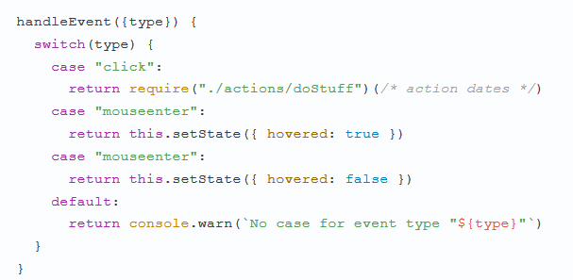
Consider writing a single event handler for your component and switching on event.type.

Slide 7
Dynamic binding in render()
The first case commonly used is calling .bind(this) in the render() function. For example:
class HelloWorld extends Component {
handleClick(event) {}
render() {
return (
<p>Hello, {this.state.name}!</p>
<button onClick={this.handleClick.bind(this)}>Click</button>
);
}
}

Slide 8
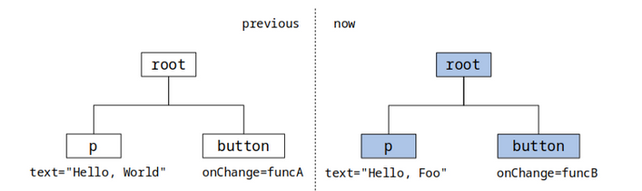
Dynamic binding in render()
This call will generate a brand-new handler, which is completely different than the handler used when render() was called the first time!

Slide 9
Bind in constructor()
An old school way is to do the binding in the constructor. Nothing fancy:
class HelloWorld extends Component {
constructor() {
this.handleClick = this.handleClickFunc.bind(this);
}
render() {
return (<button onClick={this.handleClick}/>);
}
}

Slide 10
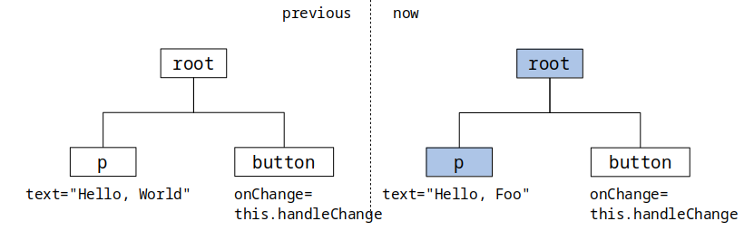
Bind in constructor()
This way is much better than previous one. Calling render() will not generate a new handler for onClick, so the <button> will not be re-rendered as long as the button does not change.

Slide 11
Bind with the Arrow Function
With ES7 class properties (currently supported with Babel), we can do bindings at the method definition:
class HelloWorld extends Component {
handleClick = (event) => {
console.log(this.state.name);
}
render() {
return (<button onClick={this.handleClick}/>)
}
}
So once the component is initialized, this.handleClick will never change again.
This way, it ensures that <button> won’t get re-rendered. This approach is probably
the best way of doing bindings. It’s simple, easy to read, and most importantly, it works.

Slide 12

Alternatively, for simple components, you can call imported actions/functions directly from components, using arrow functions.

Slide 13
Layout component

Slide 14
Layout components result in some form of static DOM element. It might not need to update frequently, if ever.
Consider a component that renders two children side-by-side.
<HorizontalSplit
leftSide={<SomeSmartComponent />}
rightSide={<AnotherSmartComponent />}
/>
We can aggressively optimize this component.

Slide 15
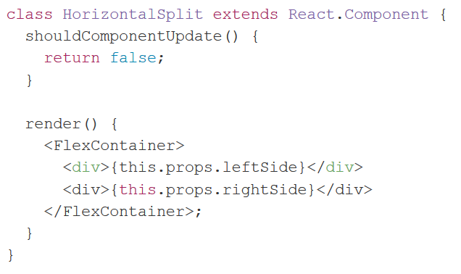
While HorizontalSplit will be parent to both components, it will never be their owner. We can tell it to update never, without interrupting the lifecycle of the components inside.

Slide 16
Container component

Slide 17

Container
Containers are your data or logic layer and utilize stateful API’s. Using lifecycle events, you can connect to a state management store such as Redux or Flux, and pass down data and callbacks as props to children components. In the container’s render method is where you compose your UI consisting of presentational children components. In order to have access to all stateful API’s, a container must be a class component as opposed to a functional component.
Blue is representing the container component while gray is the presentational

Slide 18
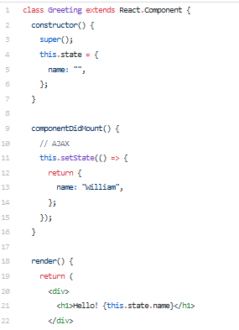
In the example below, we have a class component called Greeting, which has state, a lifecycle event componentDidMount() and render.
At this point in time, this component is a stateful class component. In order to make Greeting a container component, we can split the UI into a presentational component, which I’ll illustrate below.

Slide 19

Presentational
Presentational components utilize props, render, and context (stateless API’s) and can be the syntactically-pretty functional, stateless component:
Blue is representing the presentational component while gray is the container

Slide 20
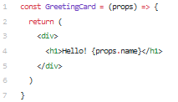
Presentational components receive data and callbacks from props only, which can be provided by its container or parent component.

Slide 21
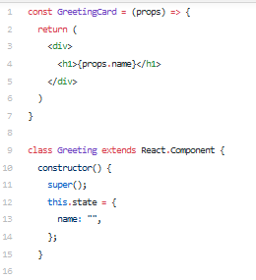
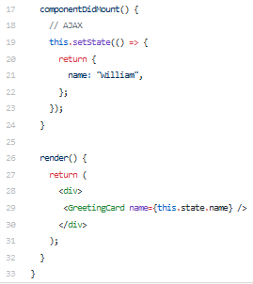

Slide 22
USEFUL LINKS
https://medium.freecodecamp.org/the-best-way-to-bind-event-handlers-in-react-282db2cf1530
https://medium.com/teamsubchannel/react-component-patterns-e7fb75be7bb0
https://reactpatterns.com/
https://medium.com/teamsubchannel/react-component-patterns-e7fb75be7bb0

Slide 23
QUESTIONS ?

Slide 24
THANK YOU

